Slide 1
Online machine learning on fully distributed data
Rerngvit Yanggratoke
PhD student KTH/EES/LCN under Prof. Rolf Stadler
20 Dec, 2014
Seminar for ID2220

Slide 2
Outline
Introduction
Distributed training strategies for the structured perceptron
Jubatus: Scalable Distributed Processing Framework for Realtime Analysis of Big Data
Gossip learning with linear models on fully distributed data
Open problems
Conclusion

Slide 3
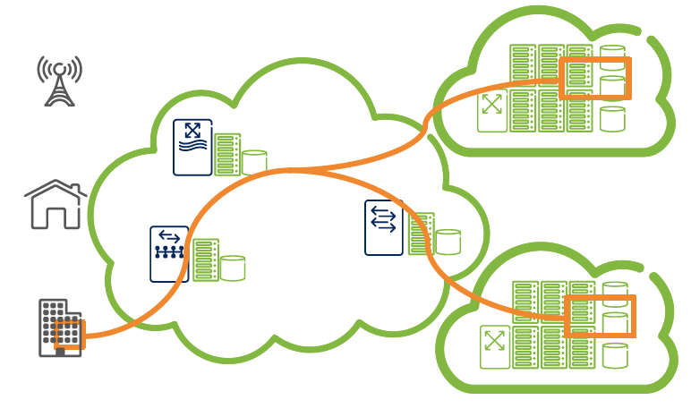
Telecom Clouds
“Cloud” on telecom operator infrastructure
Provide, for example,
On-demand connectivity, computation, storage, between customer premises and traditional cloud providers
“Telecom clouds”
Cost effective / flexible
Guaranteed QoS
How to achieve this?
Clouds produce large amount of operational and management data (OAM)
A data center of 100,000 Linux servers (at least 4.49 PB/hour raw data)
“Network analytics for management”
Notes:
Cloud infrastructure itself is a Big Data problem, because of Bla Bla Bla 2 mins

Slide 4
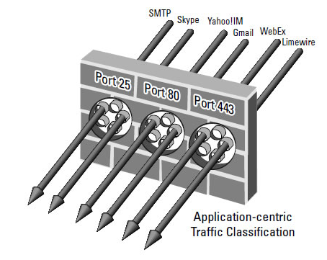

Network analytics for management
Existing works
Identify unknown network attack of a single link [MCY11]
Traffic classification [JCY13]
Anomaly detection and root cause analysis in LTE system [SN12]
Identify rogue devices based on device fingerprinting [FAR10]
Routing for quality-of-service guarantee in VoIP service overlay [HMR09]
Anomaly detection from log analyzing in Hadoop [QJY09]
…
Most of them based on analyzing data “outside the network”
Has high analytic delays
Not suitable for real-time management
Notes:
What we are going this data for?

Slide 5
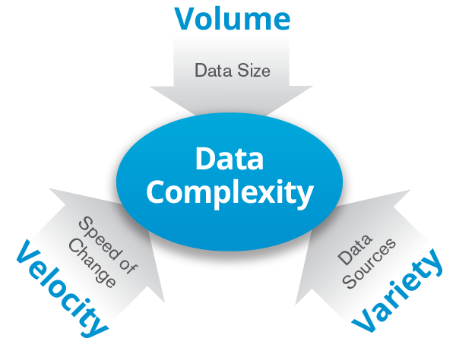
Problem: real-time network analytics
Turning this big data into “actionable insights” in a timely fashion
Service assurance / anomaly detection
Challenges
Big data 3Vs challenges
High volume - a nationwide-network has about 10 TBs/day [PMH13]
High velocity - it’s a network operational data …
High variety – heterogeneous devices
Approach
“In-network analytics”
In-network analytics architecture
Online machine learning
>> Store only the models not data
Distributed machine learning (data set size >> model size)
>> Only share models between servers

Slide 6
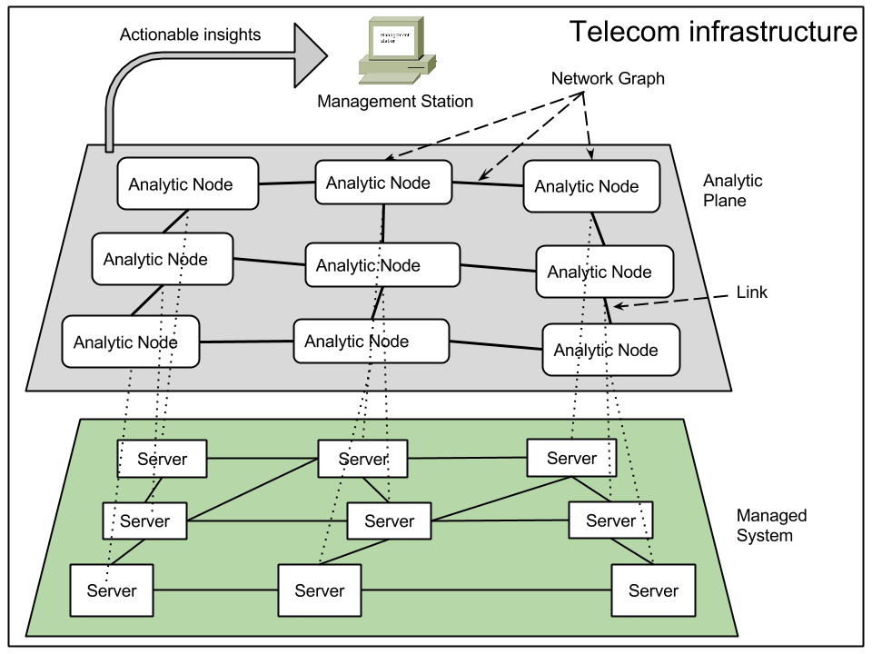
In-network analytics architecture
“Processing data at the sources”
Reduce network and storage overhead
Reduce analytic delays
Notes:
Model size << data size

Slide 7


Online machine learning
An algorithm runs in consecutive rounds. In each round, the learner
receives and makes prediction for a single sample
Is revealed a correct answer for the sample
updates its model for the subsequent samples
Example: real-time classification of QoS metrics at the application level from cloud operational and management data
Make prediction
Features of a sample
Revealed the answer
Update the model

Slide 8


Distributed learning
No raw-data movement is allowed (fully distributed data)
Build a global model in a distributed fashion
Motivation
Privacy
E.g., analytics for medical and social network apps
Architecture
E.g., space / computation power limitations
Time
E.g., intrusion detection, SLA analytics

Slide 9
Supervised learning algorithms
Distributed learning
Online learning
AROW[KC13]
Random forest [BL01]
Distributed
Perceptron
[RM10]
Passive Aggressive Perceptron[KC06]
Bagging [BL98]
Stacked generalization
[WD92]
CW Perceptron[MD08]
Gossip learning
[RO12]
Incremental SVM[PL06]
Effective Stacking
[TG02]
P2P Boosting
[IRM12]
VFDT [PD00]
Distributed Boosting [LA02]
CVFDT [GH01]
……..
……..

Slide 10
Distributed training strategies for the structured perceptron
Ryan McDonald, Keith Hall, and Gideon Mann. 2010. Distributed training strategies for the structured perceptron. In Human Language Technologies: The 2010 Annual Conference of the North American Chapter of the Association for Computational Linguistics (HLT '10). Association for Computational Linguistics, Stroudsburg, PA, USA, 456-464

Slide 11
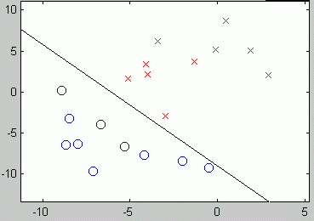
Background - Perceptron
Classic online classification algorithm (Rosenblatt 1957)
x_{i} = feature vector of the sample i
y_{i} = actual class of the sample i {1,0}
w(t) = weight vector parameter, (w₁, w₂, …, w_{n} ; w₀ = bias term)
Prediction
Learning algorithm
Initialize the w(t), e.g., all zeros.
For each training sample i
Compare h(x_{i}) and y_{i}
If misclassified, update the weights
α is the learning rate parameter
3. Repeat step 2 for N times (number of epochs) or when
(γ is the user-defined threshold)
Notes:
Introduction to Perceptron

Slide 12
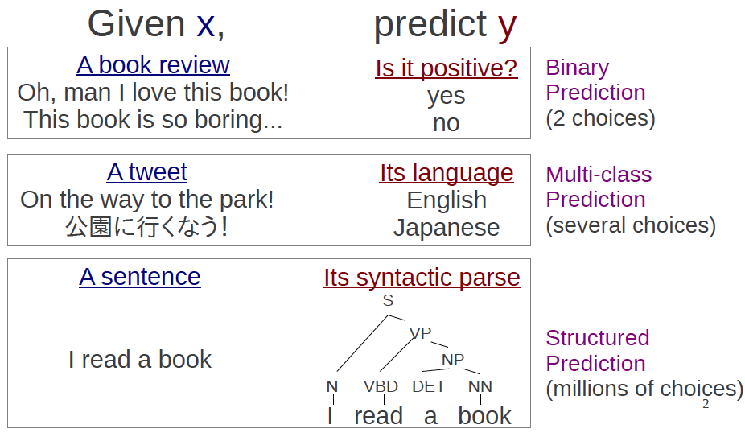
Structure Perceptron
Perceptron for structure prediction (Collins, 2002)
Credit: NLP Programming Tutorial 11, Graham Neubig
Key problem: hard to train due to #choices => take long time
Notes:
Structured perceptron is an online learning algorithm for learning the structures
Problems : -> Hard to train

Slide 13
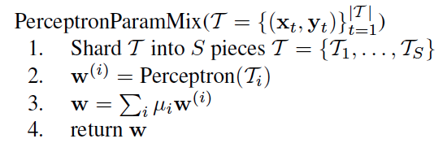
Simple distributed training
Training Data
Server 1
Server 2
Server 3
Server 4
Server 5
μ_{i} is the fraction of data for piece i
Is it guaranteed to converge to separate the training set, if the data is separable?
No!
Notes:
Can it be distributed? ➔ No , proof that is not converge

Slide 14
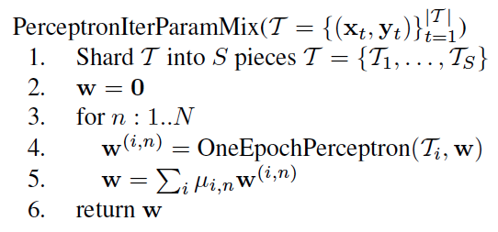
Iterative parameter mixing
Training Data
Server 1
Server 2
Server 3
Server 4
Server 5
Repeat
Is it guaranteed to converge to separate the training set, if the data is separable?
Yes!

Slide 15
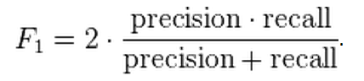
Evaluation
Named-entity recognition in English CoNLL data 2003
Detect entities in sentences and label them as
People, organizations, locations, or miscellaneous
Training dataset : 14041 sentences
Validation dataset: 3250 sentences
Compare between
Serial perceptron
Serial subsampling
Parallel parameter mix (simple distributed training)
Parallel iterative parameter mixing
Evaluation metric

Slide 16
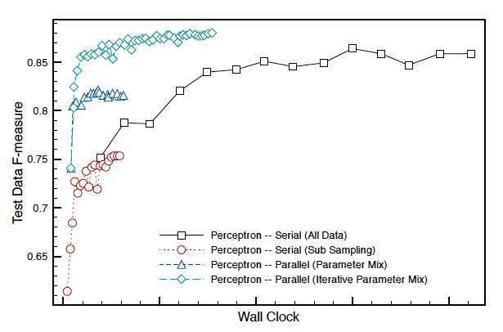
Results

Slide 17
Jubatus: Scalable Distributed Processing Framework for Realtime Analysis of Big Data
Satoshi Oda, Kota Uenishi, and Shingo Kinoshita. Jubatus: Scalable Distributed Processing Framework for Realtime Analysis of Big Data, 2012.

Slide 18

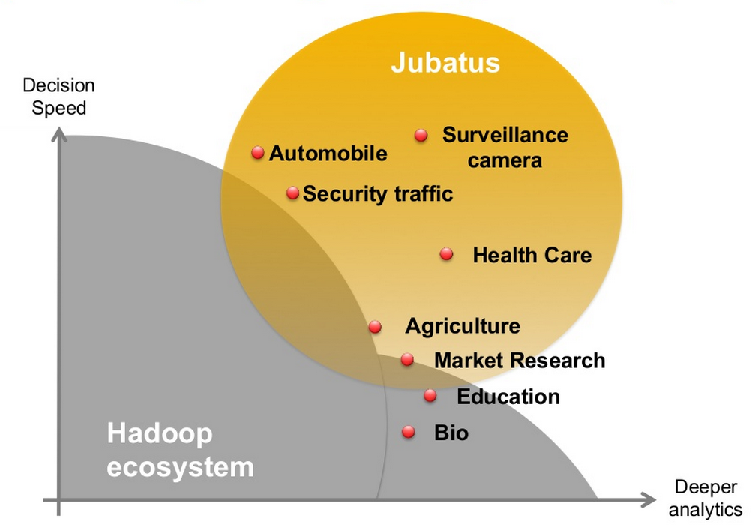
OSS Software for online and distributed machine learning
Developed by Preferred Infrastructure, Inc. and NTT laboratory in Japan
Released since Oct 2011 (https://github.com/jubatus)

Slide 19
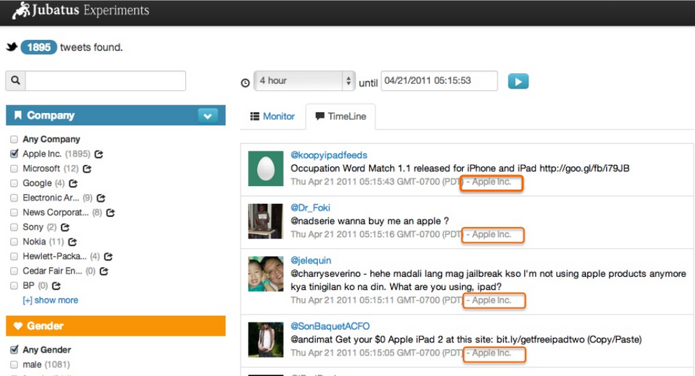
Use case
Real-time tweet classification

Slide 20
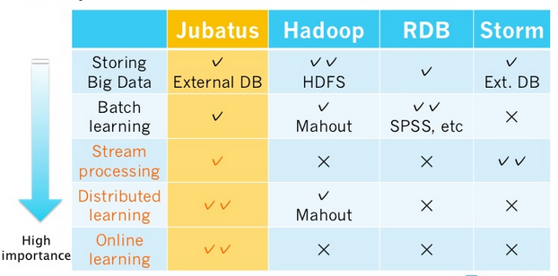
Comparison with other frameworks

Slide 21
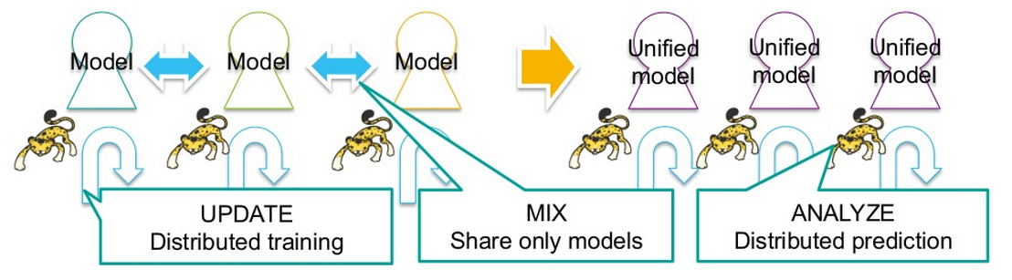
Approach
Design is inspired by “Iterative parameter mixing”
Loose model data sharing
Model size << data size
No data movement over the network
A ML developer implements 3 abstract methods
Update – Receives a sample, learn and update the local model
Mix – Exchange and merge the local models between servers
Analyze – Receives a sample, apply the local model, return result
Distribution and fault tolerant logic are provided by Jubatus

Slide 22
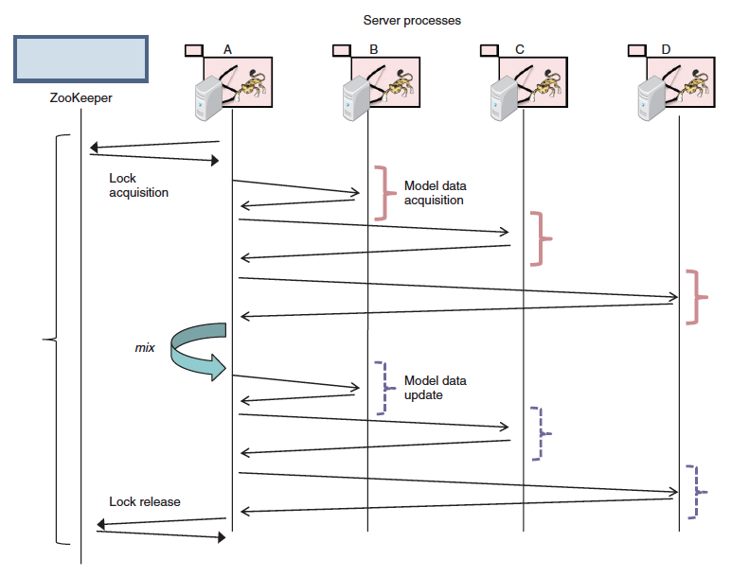
Mix operation

Slide 23
Implemented algorithms
Classification (multi-class)
Perceptron / Online Passive-Aggressive Algorithm (PA)/ Conﬁdence-Weighted Linear Classiﬁcation (CW) / Adaptive regularization of weight vectors (AROW)
Regression
PA-based regression
Nearest neighbor
LSH, Minhash, Euclid LSH
Recommendation - based on nearest neighbors
Anomaly detection
Local Outlier Factor(LOF) based on nearest neighbors
Graph analysis
Shortest path / Centrality (PageRank)
Simple statistics
Sum, Standard deviations, etc.

Slide 24
Gossip learning with linear models on fully distributed data
Róbert Ormándi, István Hegedűs, and Márk Jelasity, "Asynchronous peer-to-peer data mining with stochastic gradient descent", in Emmanuel Jeannot, Raymond Namyst, and Jean Roman, editors, Euro-Par 2011, volume 6852 of Lecture Notes in Computer Science, pages 528–540. Springer-Verlag, 2011.
Róbert Ormándi, István Hegedűs, and Márk Jelasity. Gossip learning with linear models on fully distributed data. Concurrency and Computation: Practice and Experience, 2012. to appear.
István Hegedűs, Róbert Busa-Fekete, Róbert Ormándi, Márk Jelasity, and Balázs Kégl. Peer-to-peer multi-class boosting. In Euro-Par 2012, Lecture Notes in Computer Science. Springer-Verlag, 2012. to appear.

Slide 25
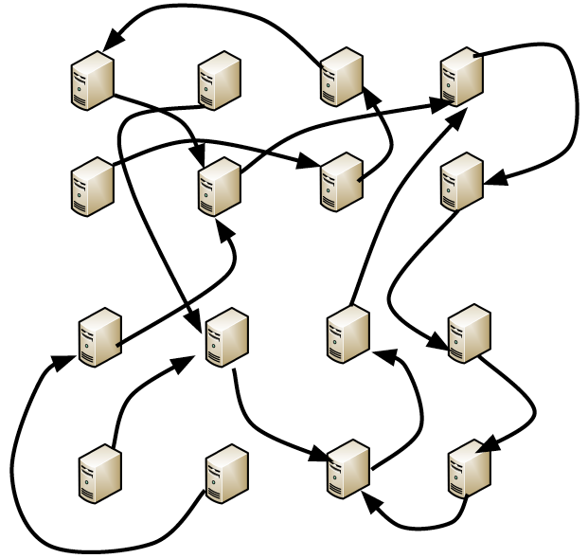
Background – Gossip Algorithm
A round-based algorithm that relies on pairwise interactions between nodes to accomplish a global objective
Each node executes the same code and the size of the exchanged message is limited
No centralized entity
A single round of gossip
Some existing gossip works
Averaging [MO05a]
Peer Sampling Service [SV05]
Topology management [MO05b]
Graph partitioning [FR13]
Resource Allocation in Cloud [RY11,FW10]
…
This talk: “gossip-based learning”

Slide 26
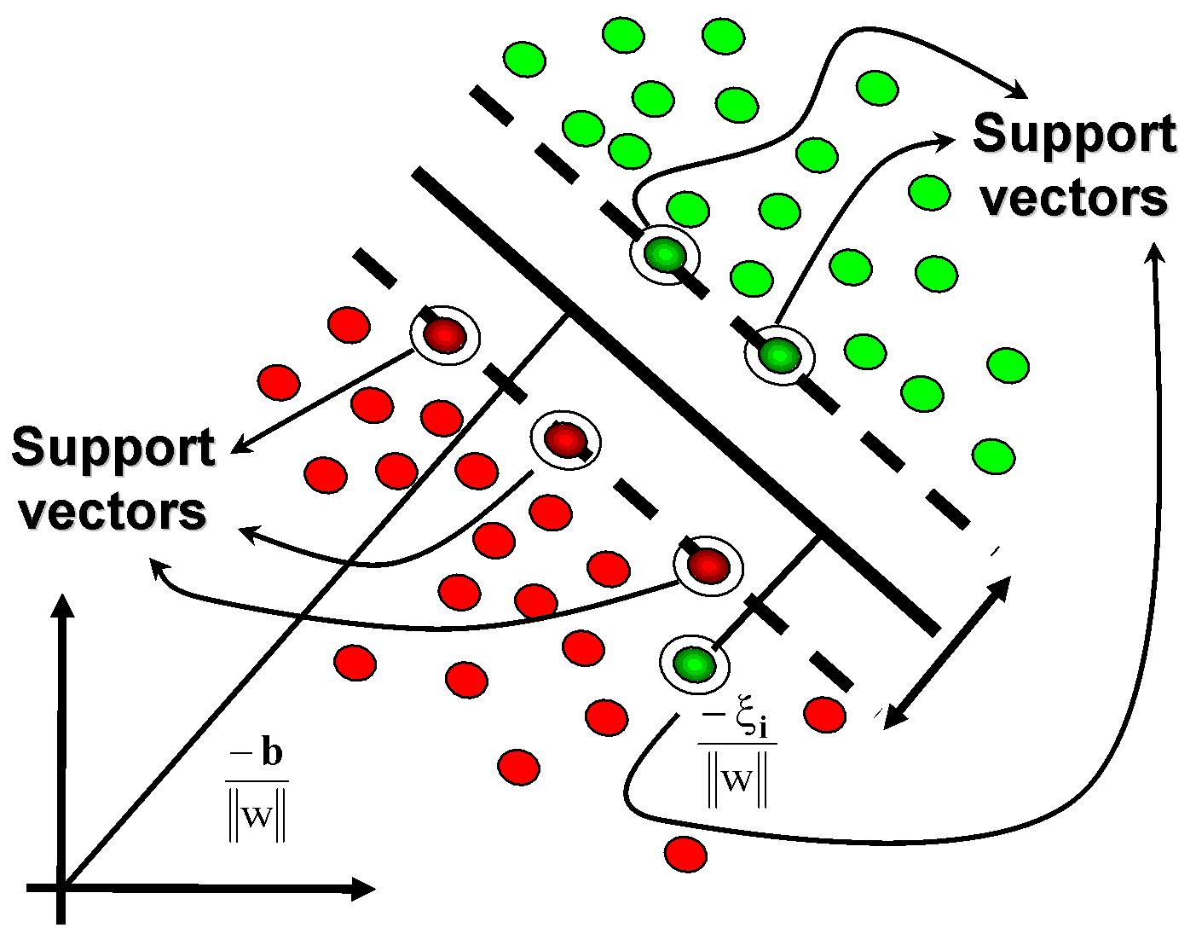
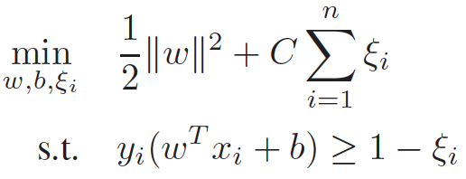
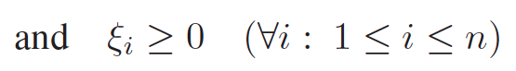
Background – SVM
Support Vector Machine(SVM) is supervised ML models for creating the maximum-margin hyperplane separating dataset.
Primal form (linearly separable data)
x_{i} = feature vector of the sample i
y_{i} = actual class of sample i {-1,1}
w = weight parameter of the model
b = bias term
= slack variable for soft margin
C = soft margin parameter

Slide 27
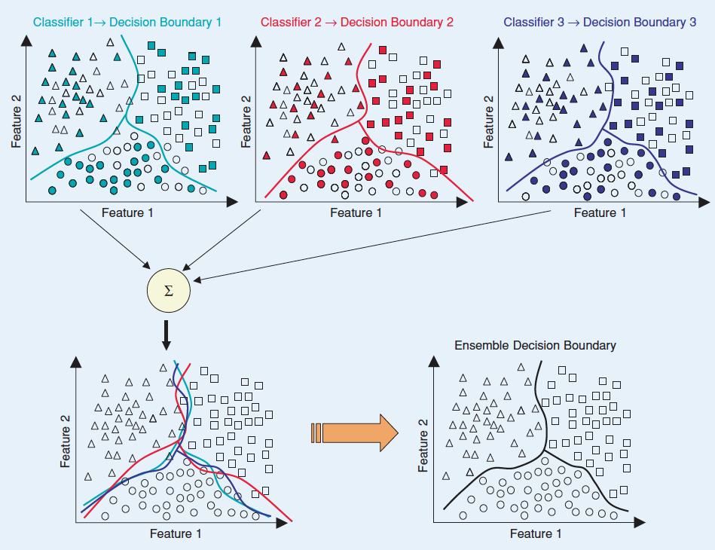
Background – Ensemble learning

Slide 28
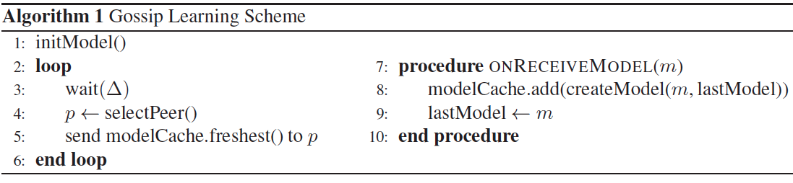
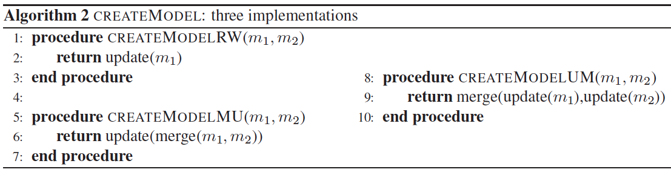
Gossip learning framework
Key components (abstract methods)
Peer sampling service : selectPeer()
Online learning : update(m₁)
Ensemble learning : merge(m₁,m₂)

Slide 29
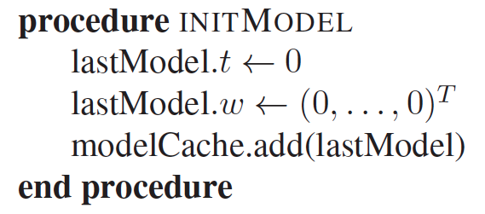
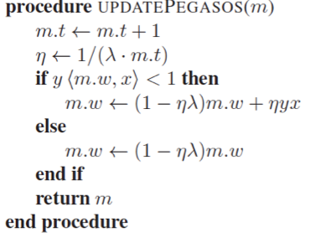
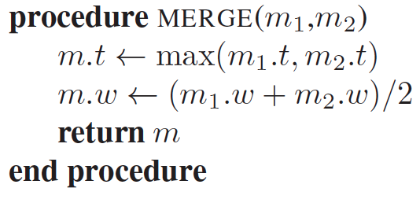
P2P SVM - Instantiation
Peer sampling service : selectPeer()
Newscast [MSR07]
2. Online learning : update(m₁)
Pegasos [SSY10]
=> m.w = model vector parameter
λ = learning rate (10⁻⁴)
m.t = number of samples seen
3. Ensemble learning : merge(m₁,m₂)
Simple averaging

Slide 30
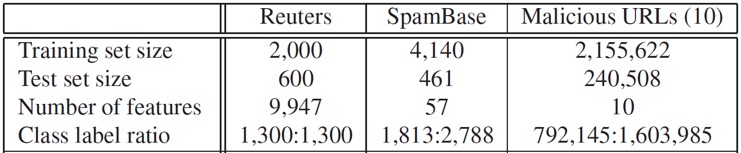
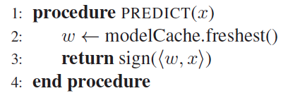
Evaluation
Model cache size = 10
Evaluation metric: prediction error (0-1) from 100 random peers

Slide 31
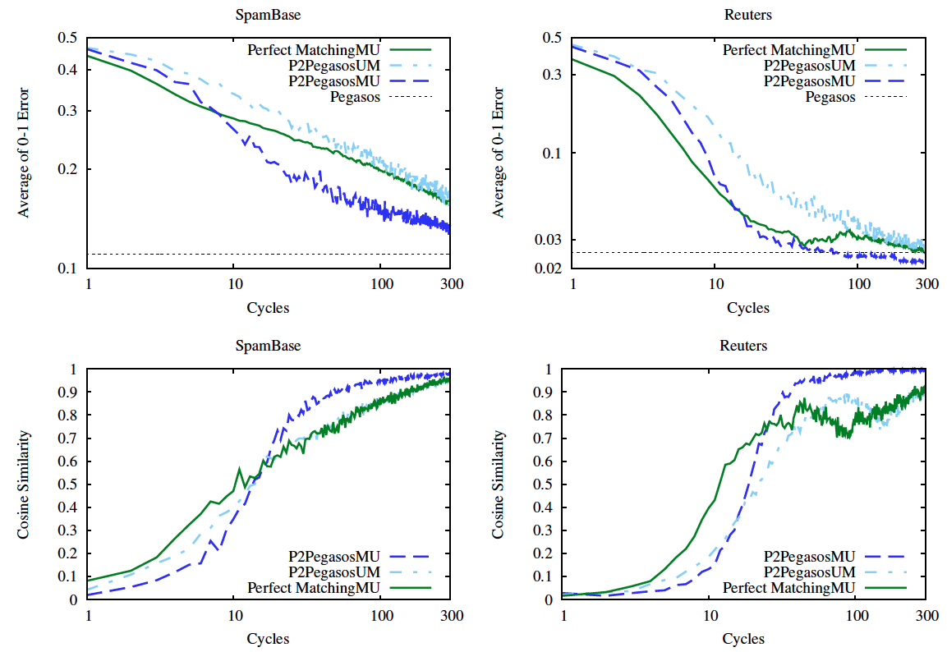
Results – general cases

Slide 32
Open problems
Linearly separable data?
Data locality
Number of features and choices
Principal Component Analysis (PCA)
Scalability
Centralized architecture
Interferences

Slide 33
Conclusion
We motivate online machine learning on fully distributed data
We describe some existing works on the concept
Distributed training method
Opensource software (Jubatus)
Gossip learning framework
Open problems
Linearly separable data?
Data locality
Number of features and choices
Interferences

Slide 34
References [1]
[BL01] Breiman, Leo (2001). "Random Forests". Machine Learning 45 (1): 5–32. doi:10.1023/A:1010933404324
[BL98] Leo Breiman. 1996. Bagging predictors. Mach. Learn. 24, 2 (August 1996), 123-140. DOI=10.1023/A:1018054314350
[WD92] Wolpert, D.H.: Stacked generalization. Neural Network. 5(2), 241-259
Effective Stacking
[TG02] Tsoumakas G., Vlahavas, I.: Effective stacking of distributed classifiers, In: ECAI, pp. 340-344 (2002)
[LA02] Lazarevic, A., Obradovic, Z.: Boosting algorithms for parallel and distributed learning. Distrib. Parallel Databases 11(2), 203-229 (2002)
[RM10] Ryan McDonald, Keith Hall, and Gideon Mann. 2010. Distributed training strategies for the structured perceptron. In Human Language Technologies: The 2010 Annual Conference of the North American Chapter of the Association for Computational Linguistics (HLT '10). Association for Computational Linguistics, Stroudsburg, PA, USA, 456-464
[RO12] Róbert Ormándi, István Hegedűs, and Márk Jelasity. Gossip learning with linear models on fully distributed data. Concurrency and Computation: Practice and Experience, 2012.
[KC13] Koby Crammer, Alex Kulesza, and Mark Dredze. Adaptive regularization of weight vectors. Machine Learning, 91(2):155–187, 2013.
[KC06] Koby Crammer, Ofer Dekel, Joseph Keshet, Shai Shalev-Shwartz, Yoram Singer; Online Passive-Aggressive Algorithms. 7(Mar):551--585, 2006
[MD08] Mark Dredze, Koby Crammer, and Fernando Pereira. 2008. Confidence-weighted linear classification. In Proceedings of the 25th international conference on Machine learning (ICML '08). ACM, New York, NY, USA, 264-271.

Slide 35
References [2]
[MCY11] Mazel, J.; Casas, P.; Labit, Y.; Owezarski, P., "Sub-Space clustering, Inter-Clustering Results Association & anomaly correlation for unsupervised network anomaly detection," Network and Service Management (CNSM), 2011 7th International Conference on , vol., no., pp.1,8, 24-28 Oct. 2011
[JCY13] Jun Zhang; Chao Chen; Yang Xiang; Wanlei Zhou; Vasilakos, A.V., "An Effective Network Traffic Classification Method with Unknown Flow Detection," Network and Service Management, IEEE Transactions on , vol.10, no.2, pp.133,147, June 2013
[SN12] Szilagyi, P.; Novaczki, S., "An Automatic Detection and Diagnosis Framework for Mobile Communication Systems," Network and Service Management, IEEE Transactions on , vol.9, no.2, pp.184,197, June 2012
[FAR10] Francois, J.; Abdelnur, H.; State, R.; Festor, O., "Machine Learning Techniques for Passive Network Inventory," Network and Service Management, IEEE Transactions on , vol.7, no.4, pp.244,257, December 2010
[HMR09] Hong Li; Mason, L.; Rabbat, M., "Distributed adaptive diverse routing for voice-over-IP in service overlay networks," Network and Service Management, IEEE Transactions on , vol.6, no.3, pp.175,189, September 2009
[SANDVINE] http://www.sandvine.com/downloads/documents/Sandvine%20Network%20Analytics-%20Product%20Overview.pdf
[JuniperNetReflex] Juniper. Bizreex. http://www.juniper.net/us/en/local/pdf/datasheets/1000443-en.pdf.
[PMH13] P. Zerfos, M. Srivatsa, H. Yu, D. Dennerline, H. Franke, and D. Agrawal. Platform
and applications for massive-scale streaming network analytics. IBM Journal of
Research and Development, 57(3/4):11:1{11:13, 2013.
[QJY09] Qiang Fu; Jian-Guang Lou; Yi Wang; Jiang Li, "Execution Anomaly Detection in Distributed Systems through Unstructured Log Analysis," Data Mining, 2009. ICDM '09. Ninth IEEE International Conference on , vol., no., pp.149,158, 6-9 Dec. 2009 doi: 10.1109/ICDM.2009.60

